Slide 1
MATH FUNCTIONS IN POSTSQL

Slide 2
PostgreSQL has various math functions that are used and applied widely.
These functions include :-
ABS()
CEIL()
FLOOR()
ROUND()
POWER()
SQRT()
MOD()
RANDOM()
TRUNC()

Slide 3
ABS()
ABS(): this function returns the absolute value of a number.
The absolute value of a number is its distance from zero on a number line, regardless of direction. This means that the absolute value of both 3 and -3 is 3 as each is 3 units away from zero.
NOTE: The absolute value is always positive, even is the original number is negative.

Slide 4
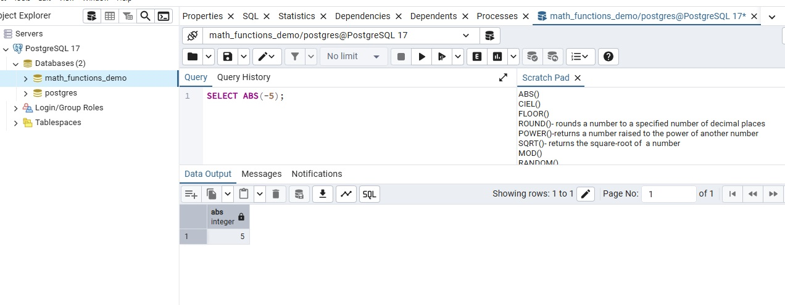
Example for ABS() using PgAdmin:

Slide 5
CEIL()
CEIL(): This function rounds up a number to the nearest integer.
It essentially returns the smallest integer that is greater than or equal to the input number, and it always chooses the integer that is on the positive side of the decimal value.
Unlike the FLOOR() function, which rounds down, CEIL() always rounds towards positive infinity.
The output of CEIL() is always an integer, even if the input is a floating point number.

Slide 6
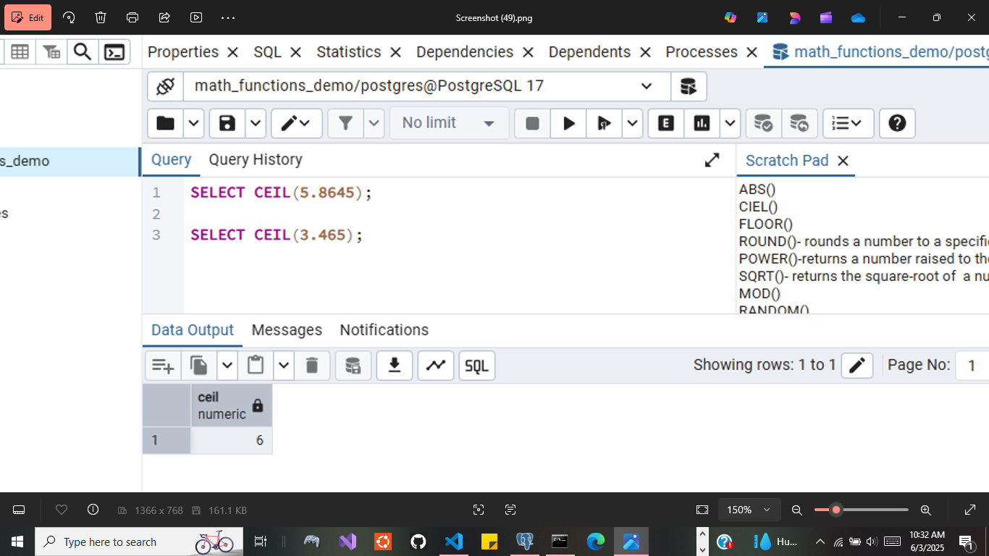
Example of CEIL() function in PgAdmin:

Slide 7
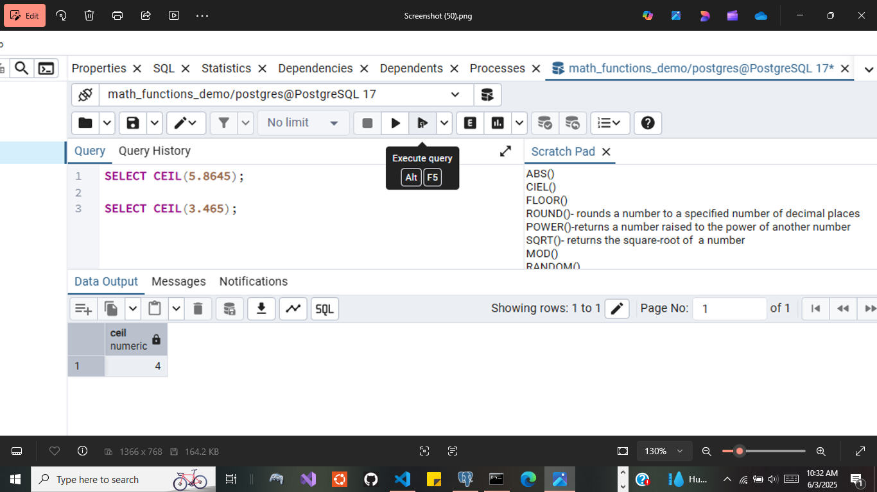
Example 2 of CEIL() function in PgAdmin:

Slide 8
FLOOR()
FLOOR(): This function rounds down a number to the nearest integer.
It takes a real number as the input and returns the largest integer less than or equal to that number.
It essentially rounds down to the nearest whole number.

Slide 9
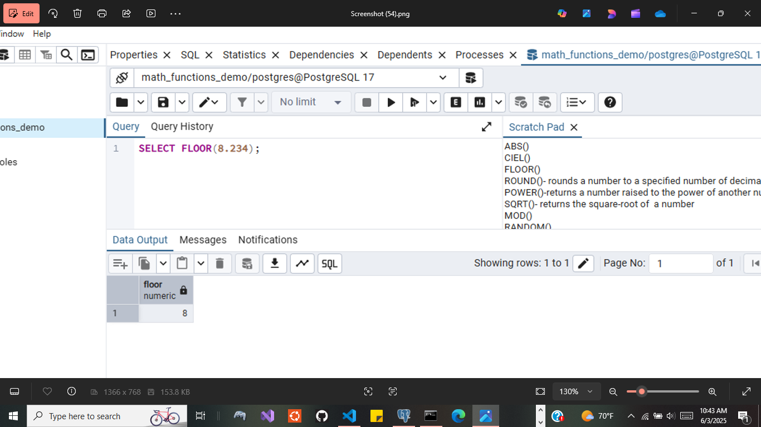
Example of FLOOR() function in PgAdmin:

Slide 10
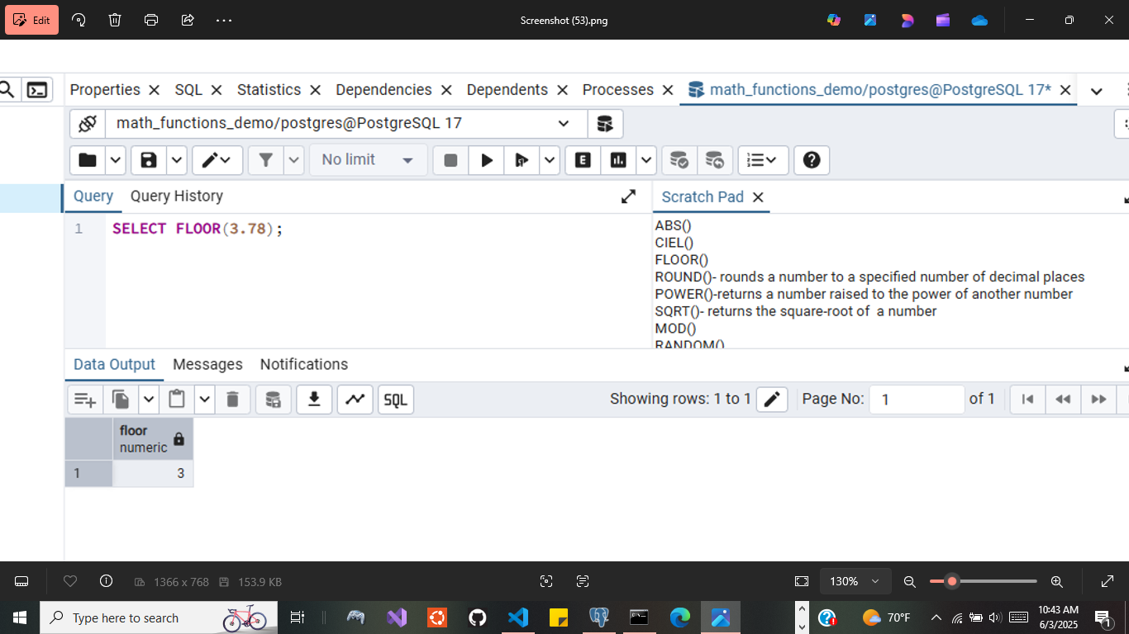
Example 2 of FLOOR() function in PgAdmin:

Slide 11
ROUND()
ROUND(): This function rounds a number to a specified number of decimal places.
This function is essential for data manipulation when precision needs to be controlled in calculations or data presentation.
It rounds up any portion of its first argument that is smaller that half a unit of the least significant digit or time unit within the precision of the second argument, but any portion of the first argument that is equal to or greater that half a unit is rounded down.

Slide 12
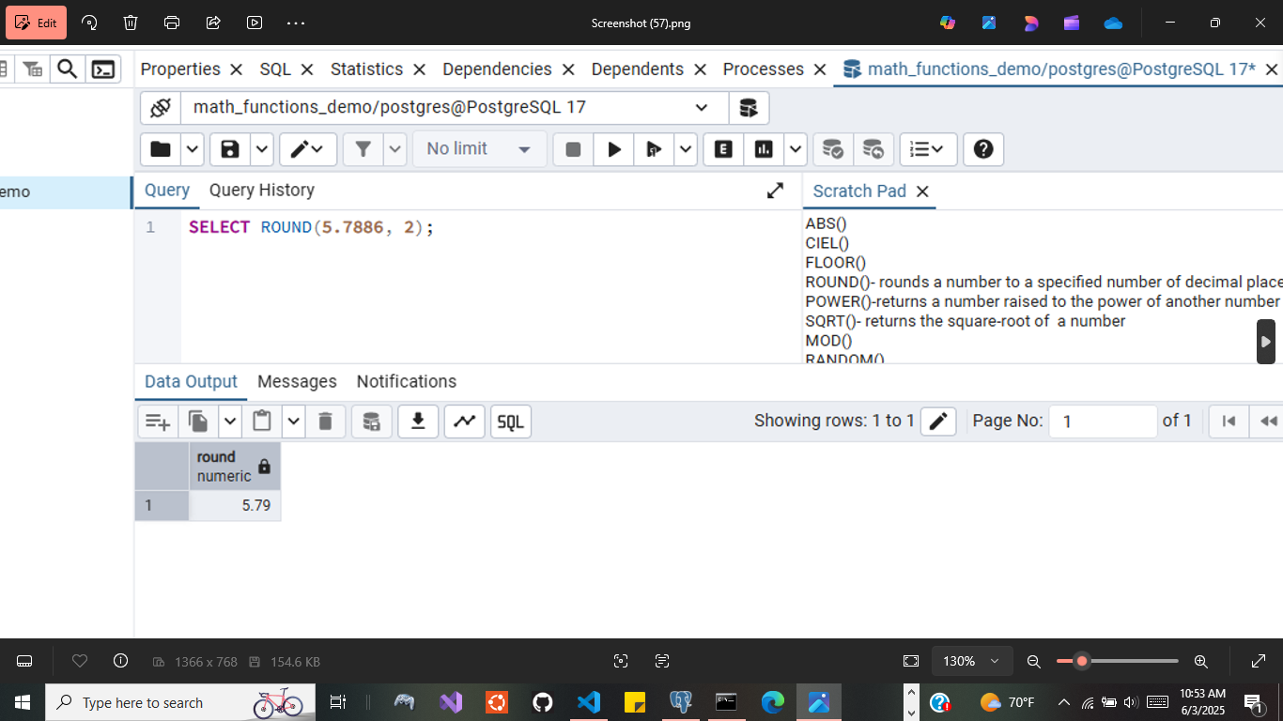
Example of ROUND() function in PgAdmin:

Slide 13
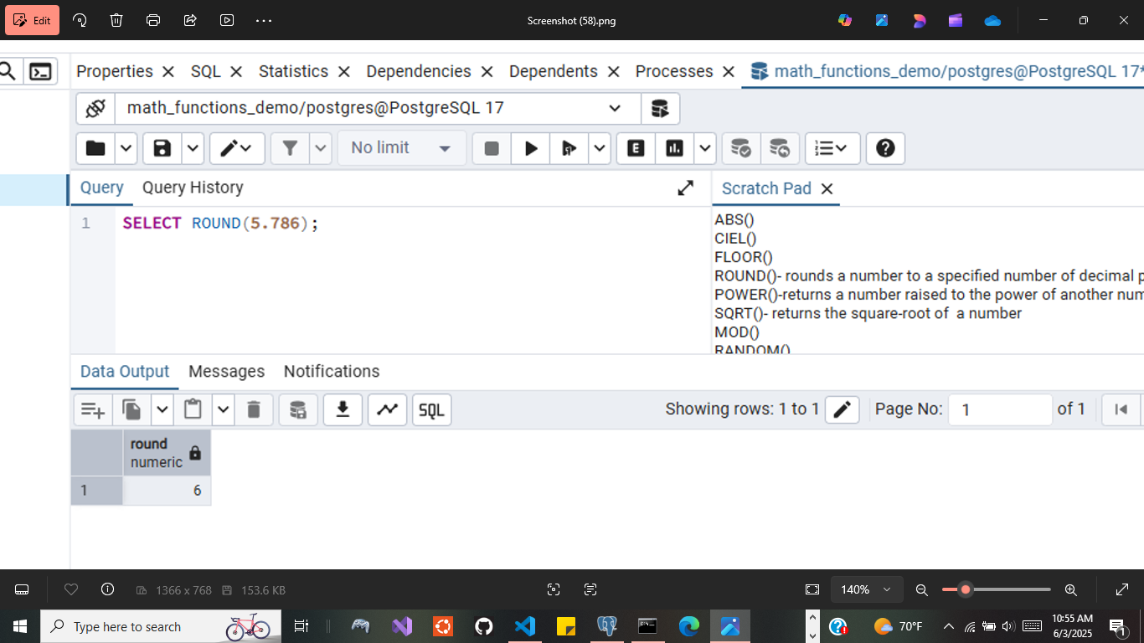
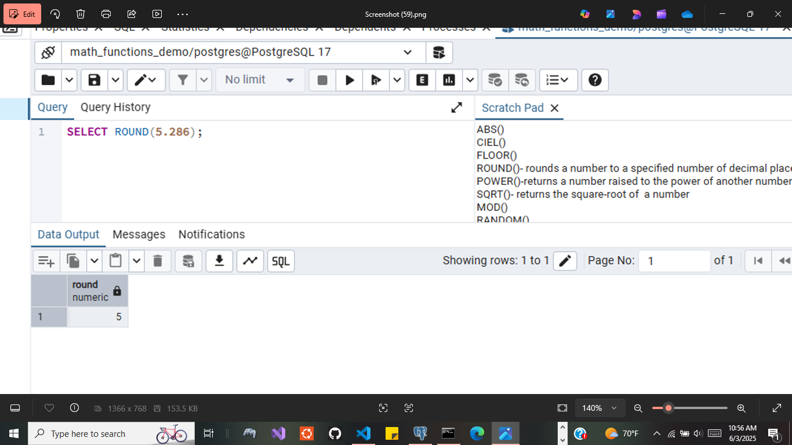
Example 2 of ROUND() function in PgAdmin:

Slide 14
Example 3 of ROUND() function in PgAdmin:

Slide 15
POWER()
POWER(): This function is used to return the value of one number raised to the power of another number.
Some uses include:
Exponential calculations: where exponentiation is involved.
Mathematical operations: useful in various formulas that require raising a number to a power.
Scientific research: employed in scientific computations involving growth rates, decay, and other exponential models.
Financial modeling: to calculate the compound interest and other financial scenarios requiring exponentiation.

Slide 16
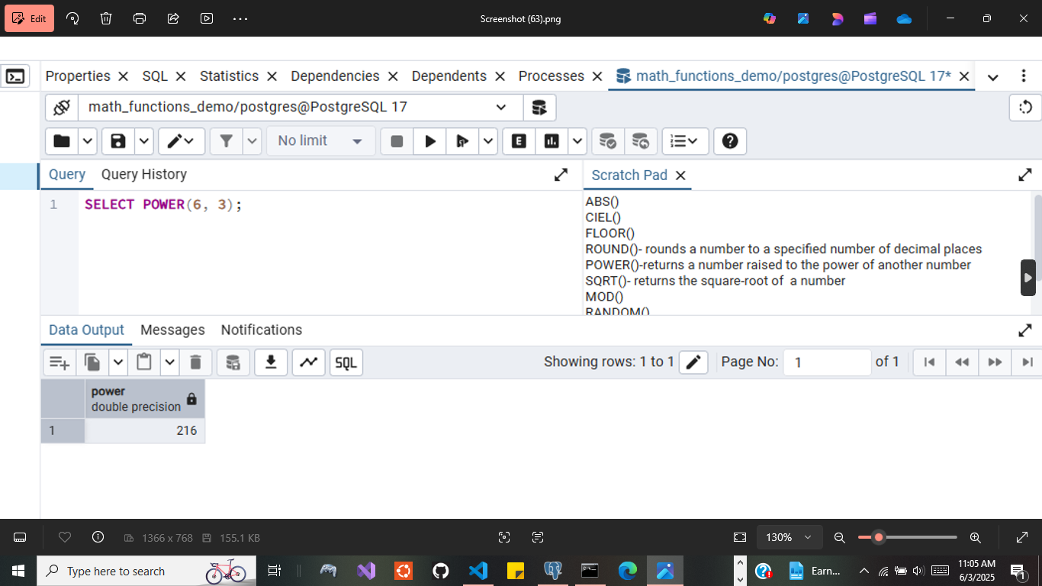
Example of POWER() function in PgAdmin:

Slide 17
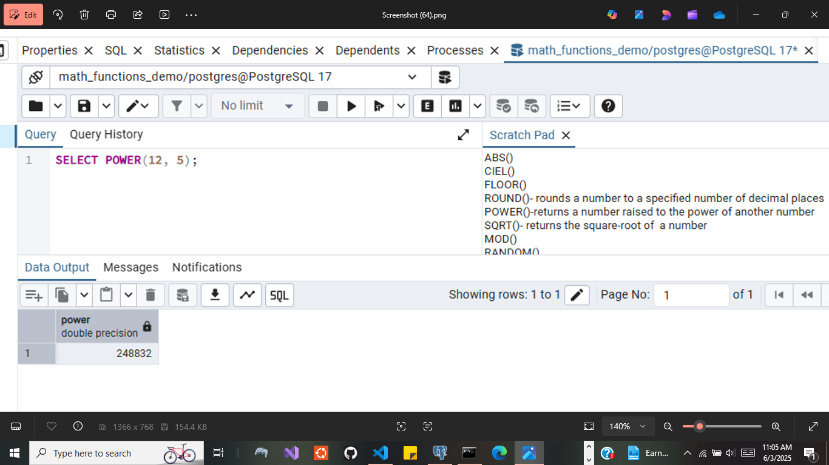
Example 2 of POWER() function in PgAdmin:

Slide 18
SQRT()
SQRT(): This function allows you to calculate the square root of a number.
The SQRT() function return the square root of the input number.

Slide 19
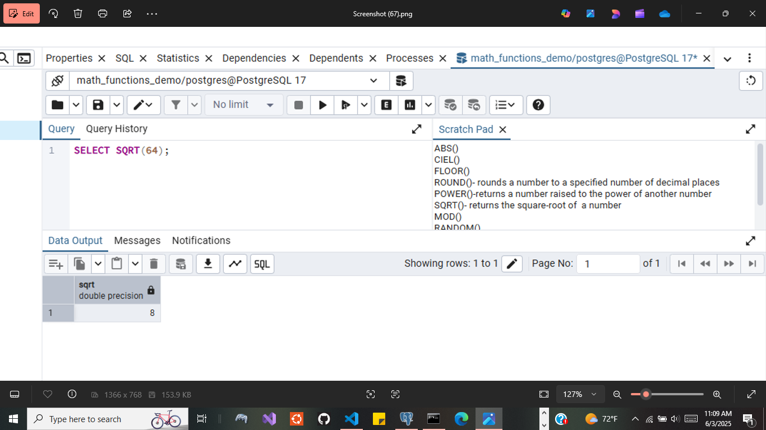
Example of SQRT() function in PgAdmin:

Slide 20
MOD()
MOD(): This function allows you to perform a modulo operation, returning the remainder after dividing the first argument by the second argument.
In this syntax: dividend: the dividend is the number that you want to divide
Divisor: Its the number by which you want to divide the dividend

Slide 21
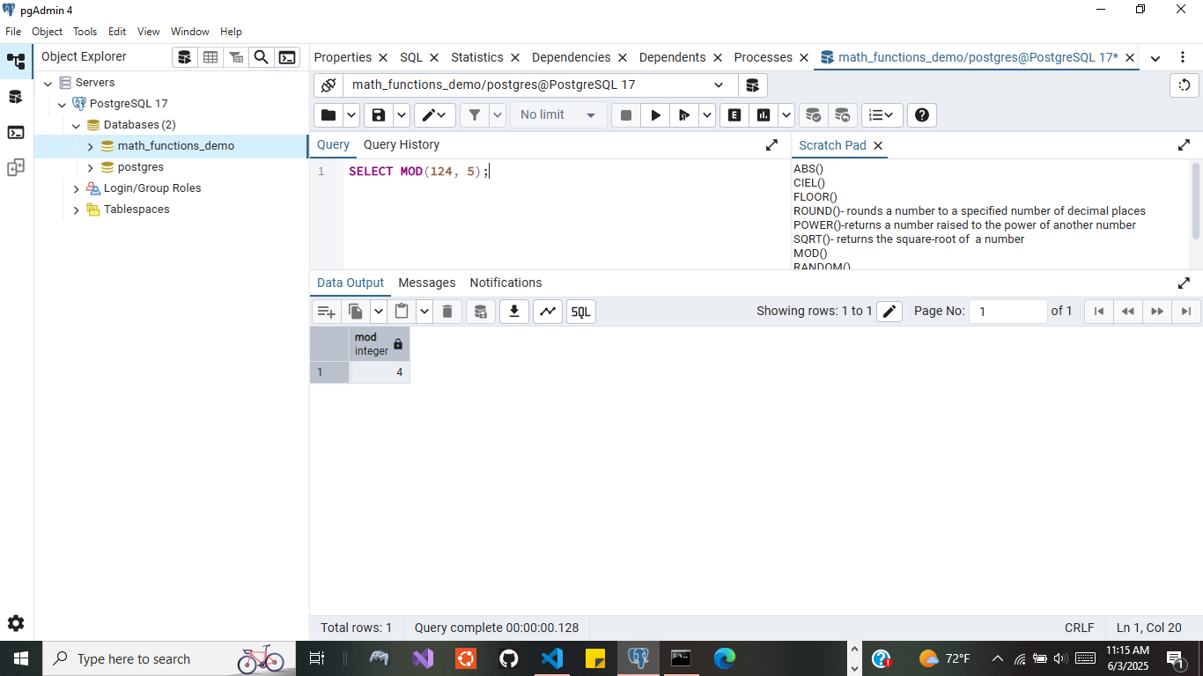
Example of MOD() function in PgAdmin:

Slide 22
RANDOM()
RANDOM(): this function generates random floating point values between 0.0 and 1.0.

Slide 23
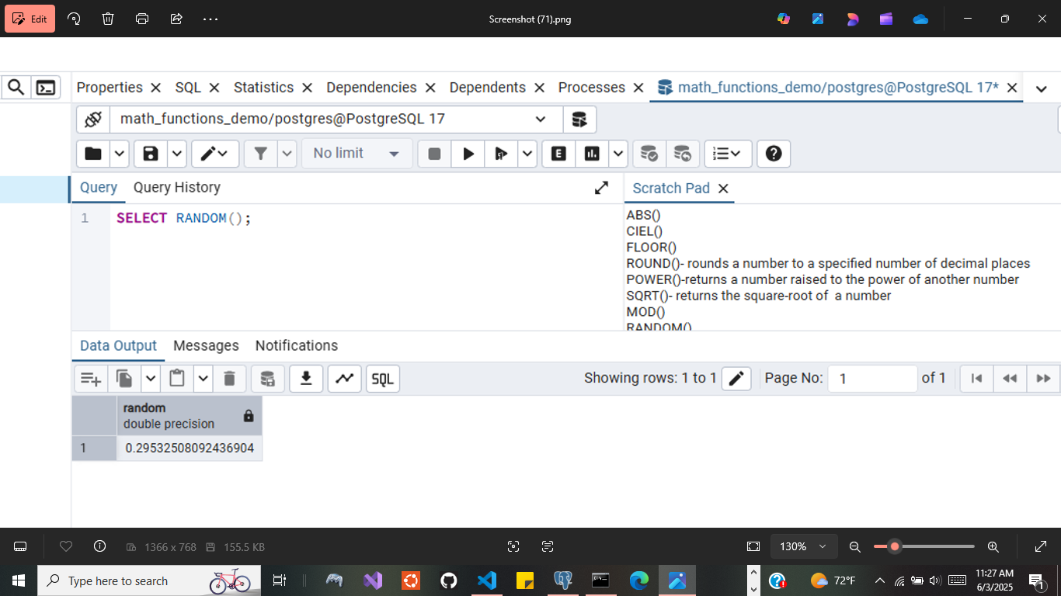
Example of RANDOM() function in PgAdmin:

Slide 24
TRUNC()
TRUNC(): This function returns a number truncated to a whole number or truncated to a specified decimal place.

Slide 25
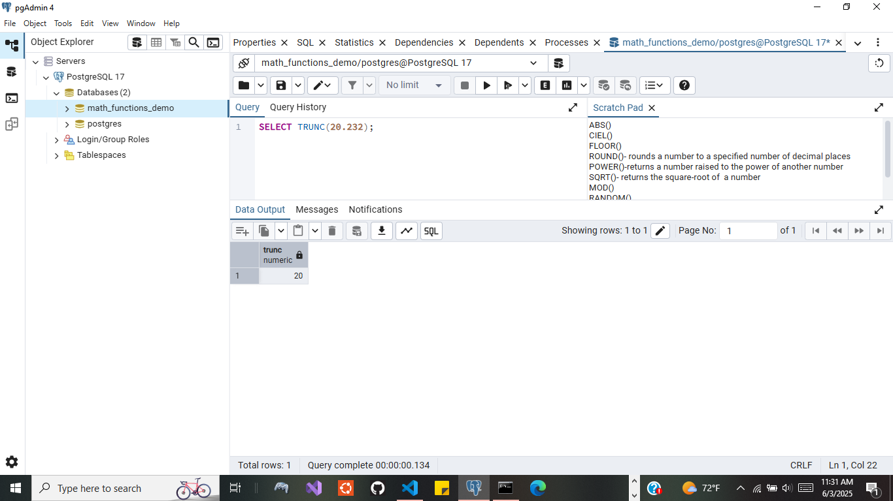
Example of TRUNC() function in PgAdmin:

Slide 26

Example 2 of TRUNC() function in PgAdmin:

